Slide 1
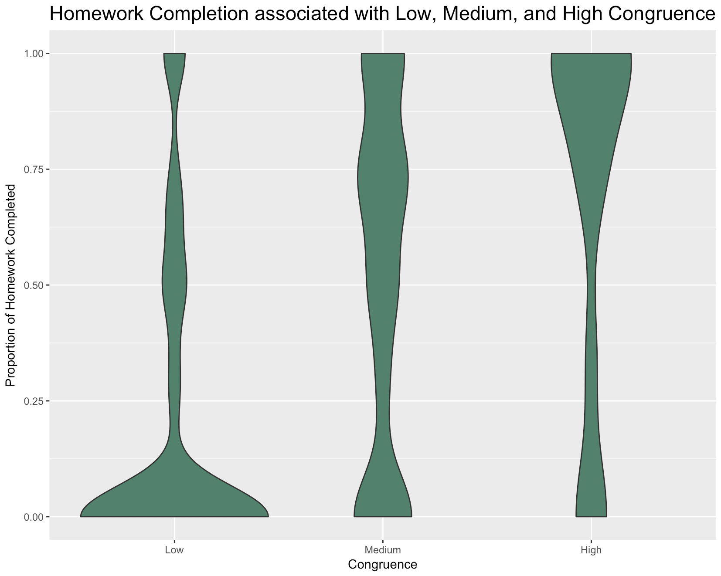
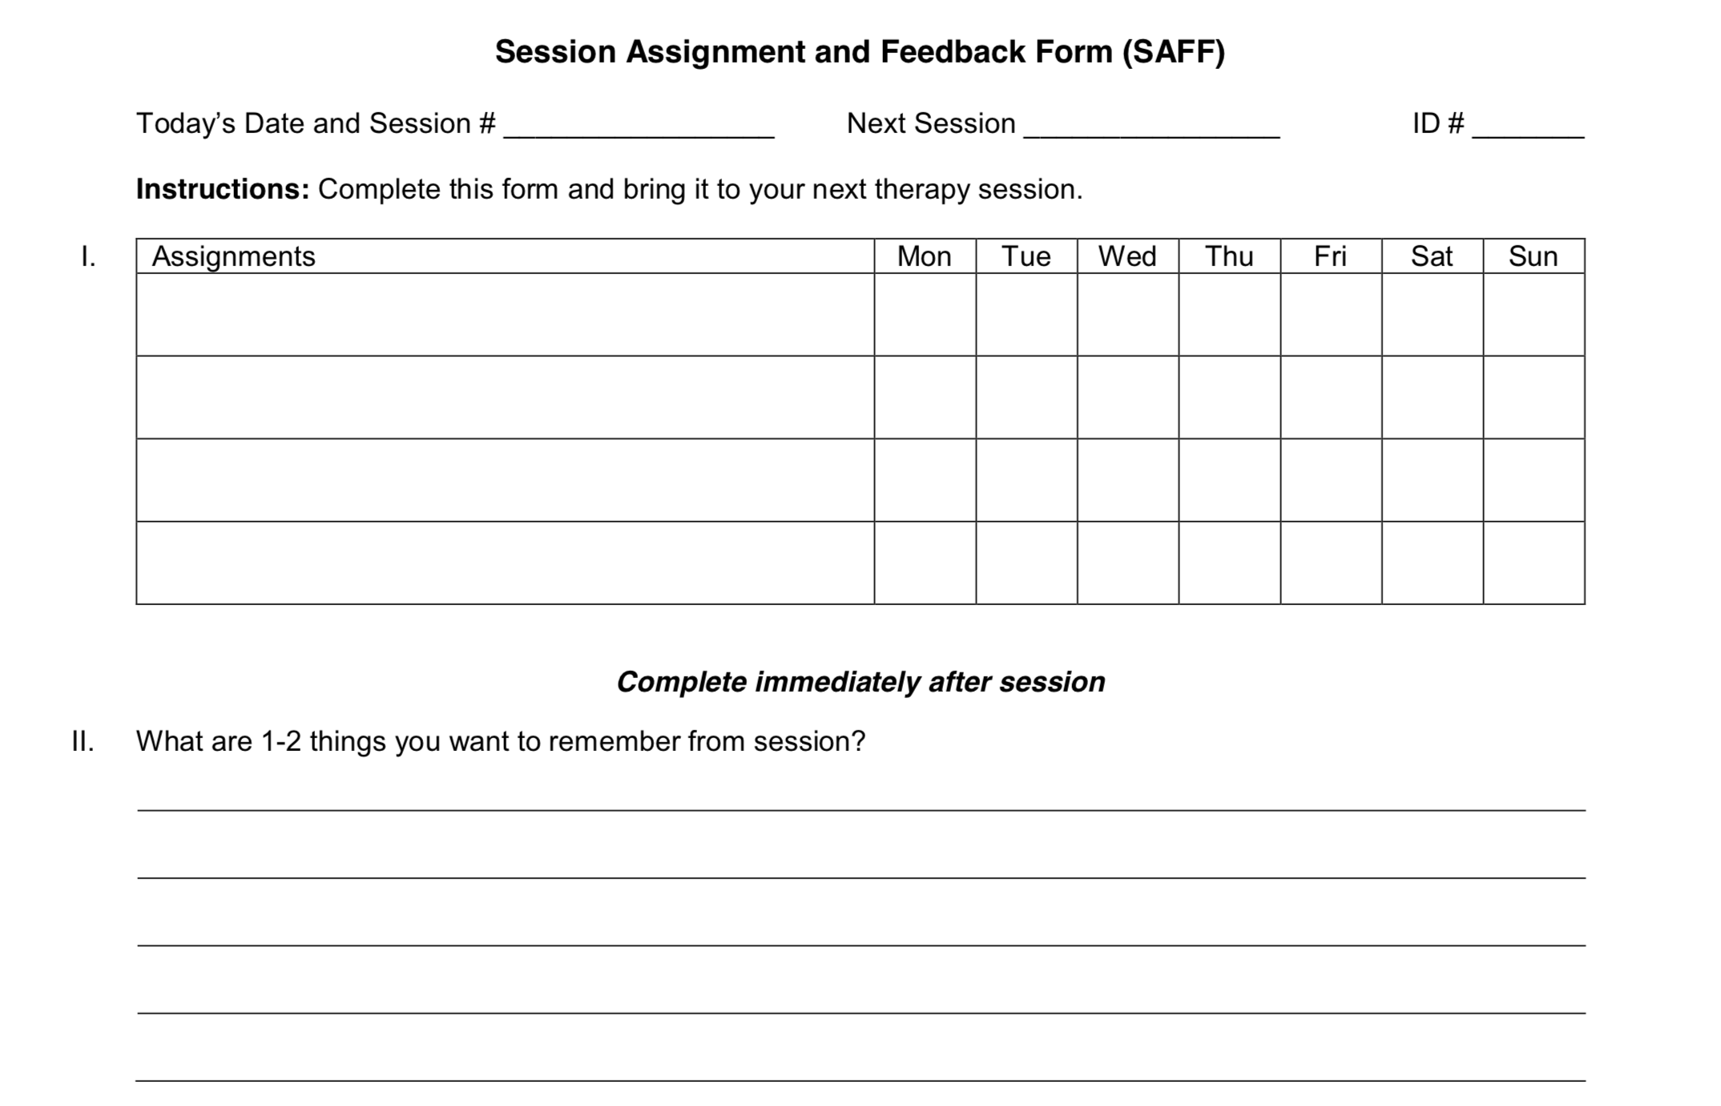
Congruence Between What a Patient Reports Learning in Session and the Content of Homework Assignments Predicts Homework Compliance in Naturalistic CBT
Alexandra S. Jensen¹, Jacqueline B. Persons¹, Connie Fee¹, Anthony L. Miles¹, Victoria L. Beckner², Polina Eidelman¹, Janie J. Hong¹, & Daniela Owen³
¹ Cognitive Behavior Therapy and Science Center, Oakland, CA
² San Francisco Group for Evidence-Based Psychotherapy, San Francisco, CA
³ San Francisco Bay Area Center for Cognitive Therapy, Oakland, CA
Introduction
Homework compliance in psychotherapy is associated with better outcome, but little is known about factors influencing homework compliance
Hypothesis: Patients are more likely to complete homework when assignments are congruent with session content they report wanting to remember
Congruence is similarity in content between homework items assigned and material patient reports wanting to remember, rated as Low (0-25% of assignments congruent), Medium (26-75% congruent), or High (76-100% congruent)
Number of Lines written in Section II is counted
Interrater reliability for congruence rating was 91% between two blind independent raters (ASJ and ALM)
Procedure
Data were culled from clinical records of patient participants in a study of the relationship between the SAFF and treatment outcome who also used the SAFF to track homework completion
Patients gave informed consent for participation; the study was approved by the Behavioral Health Research Collective IRB
Analyses
Generalized linear mixed modeling (GLMM) using R, with data from each SAFF nested within participant
Dependent variable was Number of Homework Items Completed, main independent variable was Congruence
Covariates were Number of Lines, Therapist, Session Number, and demographic and diagnostic variables
Analyzed model fit using AIC, BIC, and significance testing
Method
Participants
43 outpatients receiving naturalistic CBT from 5 therapists at 3 private practices in California
72% female, 83.7% white, 53.4% married, 58.1% employed full-time, 48.8% have a mood disorder, 39.5% have an anxiety disorder
Measures
Data were recorded on the Session Assignment and Feedback Form (SAFF), a form intended to solidify learning, record homework completion, and provide therapist feedback
Number of Homework Items Assigned is counted in Section I (see below)
Number of Homework Items Completed is indicated by one or more checkmarks following an assignment
Material Patient Reports Wanting to Remember is written by the participant in Section II (see below)
Discussion
Therapists may be able to increase homework compliance by choosing homework assignments tied to work done in session that the patient reports was useful
Limitations
Small sample of mostly white, highly educated patients
Selection criteria may limit generalizability
Number of homework items completed, as measured by patient checkmarks, may under-estimate (or over-estimate) actual homework completion
Results
Best-fit model showed a large and statistically significant effect of congruence on homework compliance, with a fixed effect coefficient estimate of ${\hat{β}}_{1}$ = 0.65 and a standard error of 0.11 (p < 0.001)
This effect corresponds to 0.92 more homework assignments completed per level of congruence
Best-fit model is based on the Poisson distribution and includes a random slope and random intercept and an offset term (Number of Homework Items Assigned)
No significant effect found for any covariate
Main effect of congruence on homework completion remained significant in all models that included covariates
Selected References
Kazantzis, N., Whittington, C., & Dattilio, F. (2010). Meta-analysis of homework effects in cognitive and behavioral therapy: A replication and extension. Clinical Psychology: Science and Practice, 17, 144–156.
Mausbach, B. T., Moore, R., Roesch, S., Cardenas, V., & Patterson, T. L. (2010). The relationship between homework compliance and therapy outcomes: An updated meta-analysis. Cognitive Therapy and Research, 34, 429–438.
Notes:
Colors: Light = 17A374, Medium = 40846D, Dark = 566B66

